Slide 1
Big Data – Introduction
Lecture 1 with Class questions

Slide 2
What we are going to cover
Introduction to Big Data & Business benefits
Storing Big Data, Data stores
Processing Big Data with Hadoop
HDFS, Hbase
Data Lakes
MapReduce
Hive & Pig
Moving to real time Big Data - Spark, Storm
Big Data Queuing - Apache Kafka
Big Data Architecture
Big Data & Cloud computing
Data Governance & Implementing a Big Data Solution

Slide 3
Background (I)
In the past Computers got faster every year through processor speed increases and this made our applications go faster
the new processors each year could run more instructions per second than last year’s; applications automatically got faster without any change.
Apps were designed to run on a single processor and rode the trend of improved processor speeds to scale up for improved performance
This trend in hardware stopped around 2006: due to hard limits in heat dissipation, hardware developers stopped making individual processors faster annually, and switched towards adding more parallel CPU cores all running at the same speed.
This meant that applications needed to be modified to add parallelism to run faster. This set the scene for new programming models such as Mapreduce, Spark

Slide 4
Background (II)
Also, Technologies for storing and collecting data did not slow down appreciably in 2006 when processor speeds did
The cost to store 1 TB of data continues to drop by roughly 2x every 14 months - it is inexpensive for organisations to store large amounts of data
Technologies for collecting data eg sensors, cameras etc continue to drop in cost and improve in resolution.
For example, camera technology continues to improve in resolution and drop in cost per pixel every year, to the point where a 12-megapixel webcam only costs 3-4 US dollars; this has made it inexpensive to collect a wide range of visual data, from people filming video or automated sensors in industry

Slide 5
Some Terminology
Kilobyte (KB) 1000 bytes 10³ bytes
Megabyte (MB) 1000 KB 10⁶ bytes
Gigabyte (GB) 1000 MB 10⁹ bytes
Terabyte (TB) 1000 GB 10¹² bytes
Petabyte (PB) 1000 TB 10¹⁵ bytes
Exabyte (EB) 1000 PB 10¹⁸ bytes
Zettabyte (ZB) 1000 EB 10²¹ bytes
According to Forbes, by the year 2020, about 1.7 megabytes of new information will be created every second for every human being on the planet.

Slide 6
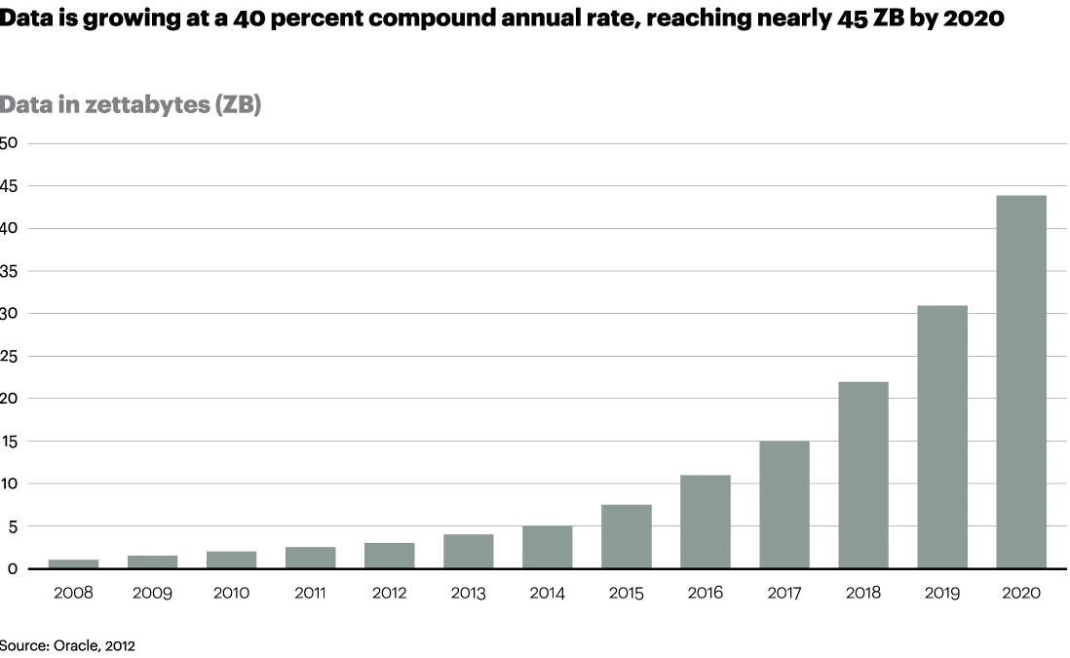

Slide 7
Data Tsunami
How it was until relatively recently - businesses generally managed data that was entered manually into the system by human beings. They may have also had data from external sources, such as customers, clients
The amount of data was relatively small and predictable and it was stored, managed, and secured in a company’s data center known as “on-premises”.
Today, the world is experiencing a data tsunami with data available from a variety of sources. The volume, complexity of this data quickly overwhelm a conventional, on-premises system and probably cause data processing and analysis to hang or crash the system
Adapting to the exponential increase of data requires a fresh perspective

Slide 8
Where is this Big Data coming from
Here is a brief list of some common sources:
Updating Facebook, Snapchat, Twitter etc
Making a phone call
Checking email
Browsing the Web
Shopping - either online or in a brick-and-mortar store, and whether you buy or not!
Driving a car
Adjusting a thermostat
Wearing a medical device
There are many data creating events - a person’s data footprint can get very big in just a single day. If you multiply that by the billions of smartphones, sensors, medical devices cameras that are working away, data gets very big
Forbes states about 1.7 megabytes of new information will be created every second for every human being on the planet in 2020)

Slide 9
Sources of Big Data
Social Media Data: From Facebook, Twitter, Snapchat, Instagram Linkedin etc.
Black Box Data: Data from airplanes, helicopters jets etc. which capture the movement and microphones data
Stock Exchange Data: Information about the buy and sell done by customers in stock exchange
Power Grid Data: Power grid holds information consumed by particular nodes
Transport Data
Search Engine Data
Sentiment Data: Data received from the comments/shares done on some blog posts or news
Sensor Data: Barcode reader data
Example: a modern hybrid car can generate around 25 gigabytes of data per hour

Slide 10
Big Data is Big!
Over 1 billion Google searches are made and 294 billion emails are sent everyday
Every minute, 65,972 Instagram photos are posted, 448,800 tweets are composed, and 500 hours worth of YouTube videos are uploaded
By 2020, the number of smartphone users could reach over 6 billion
And taking Internet of Things (IoT) into account, there could be 26 billion connected devices by then

Slide 11
Big Data is here!
Data growth, speed and complexity are being driven by deployment of billions of intelligent sensors and smart devices (Internet of Things (IoT) that are transmitting data and by other sources of semi-structured and structured data
The data must be gathered continually, analysed, and then provide direction to the business intelligence on what appropriate actions to take, thereby providing value
Massive growth in data and lower cost of computing (using Clusters of computers) to process it.
Hadoop gives the ability to perform distributed storage and distributed processing of very large data sets on computer clusters built from commodity hardware
Moving away from Vertical scaling (scaling up – shared memory architecture adding more CPU, Memory, Storage – more expensive & less scalable) to horizontal scaling (scaling out – shared nothing architecture – cheaper to scale using commodity hardware & more scalable)

Slide 12
Why Does Big Data matter?
An Accenture study reveals that 79 percent of corporate executives surveyed believe that ‘companies that do not embrace big data will lose their competitive position and may even face extinction’.
83 percent have taken on big data projects with the aim of outperforming others in their respective industries.
As a survey by New Vantage Partners shows that it delivers most value to enterprises by reducing costs (49.2%) and driving innovation (44.3%)

Slide 13
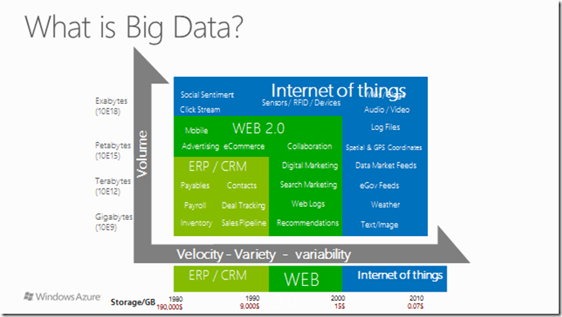

Slide 14
Web 2.0 (Read-Write)
Web 2.0 an evolution from the original Web which can be compared to a library
Web 1.0 was essentially an information dump, a place where people just placed walls upon walls of text which other users can read but cannot change or contribute.
Web 2.0 changed this by allowing user interaction with dynamic websites that acted more as applications than simply pages of information. You can still use it to receive information, but you also contribute to the conversation and make it a richer experience
Examples of Web 2.0 applications are Youtube, Facebook, Snapchat etc
It moves away from PC Browser only to include mobile devices (tablets, smartphones)

Slide 15
Web 3.0
Web 2.0 uses the Internet to make connections between people, Web 3.0 will use the Internet to make connections with information.
It is the “executable” phase of Word Wide Web with dynamic applications, interactive services, and “machine-to-machine” interaction.
Based on AI and Big Data

Slide 16
Our daily interaction with Web 3.0 include
Technologies like virtual assistants (eg Siri, Alexa, Google Assistant, Cortana), retina displays and 5G Internet, which have drastically improved our web experience, are all products of Web 3.0.
These AI assistants support natural language, meaning you can say something relatively complex into your phone/computer and it will pick apart the important component(s) of your speech & then follow your commands, like to make a reminder, send an email or do a search
For example, if you are driving in Ealing and ask you Cortana like device for a good comedy movie to watch in the area followed by an Italian restaurant which has vegan pizza selection nearby, it should take care of it all ...

Slide 17
Business strategy drives the need for Big Data
Technology strategy is driven from the Business
Various Digital business models work necessitate Big Data!
Several of the technology innovation for Big Data have come from the implementation of these business models. Eg Google, Yahoo giving rise to Hadoop, Hbase etc

Slide 18
Example: Disruptive Business Models - Free Model
This disrupts with an “if you are-not-paying-for-the-product-you-are-the-product” model that involves selling personal data or ‘advertising eyeballs’ collected by offering consumers a ‘free’ product or service that captures their data/attention.
Being “Free”, it attracts a lot of users - the more the users, the more data can be extracted. Big Data and Data Analytics play a fundamental part.
The Free Model is not charging because the data is being sold and the attention of the end user is being sold. When the data is combined with advertising, it tends to be much more targetted and effective
Examples are Google, Facebook, Snapchat
Ethical issues ?

Slide 19
Big Data Definition – The 4 “V”s
Volume - Significant Increased volumes of data; Big Data requires processing high volumes of data eg data of unknown value, such as twitter data feeds, clicks on a web page, network traffic, sensor-enabled equipment capturing data at the speed of light, and many more. It is the task of Big Data to convert low-density data into high-density data, that is, data that has value. For some companies, this might be tens of terabytes, for others it may be hundreds of petabytes (1 Petabyte = 1,000,000 Gigabyte)
Velocity - A fast rate that data is received and acted upon. Some internet-enabled smart products operate in real-time or near real-time. As an example, consumer eCommerce applications seek to combine mobile device location and personal preferences to make time sensitive offers. Operationally, mobile application experiences have large user populations, increased network traffic, and the expectation for immediate response.

Slide 20
Big Data – 4 “V” Continued
Variety - Unstructured and semi-structured data types, such as text, audio, and video require additional processing to both derive meaning and the supporting metadata. Once understood, unstructured data has many of the same requirements as structured data, such as summarization, lineage, auditability, and privacy. Further complexity arises when data from a known source changes without notice. Frequent or real-time schema changes are an enormous burden for both transaction and analytical environments.
Value - Data has intrinsic value—but it must be discovered. There are a range of quantitative and investigative techniques to derive value from data – from discovering a consumer preference or sentiment, to making a relevant offer by location, or for identifying a piece of equipment that is about to fail.

Slide 21
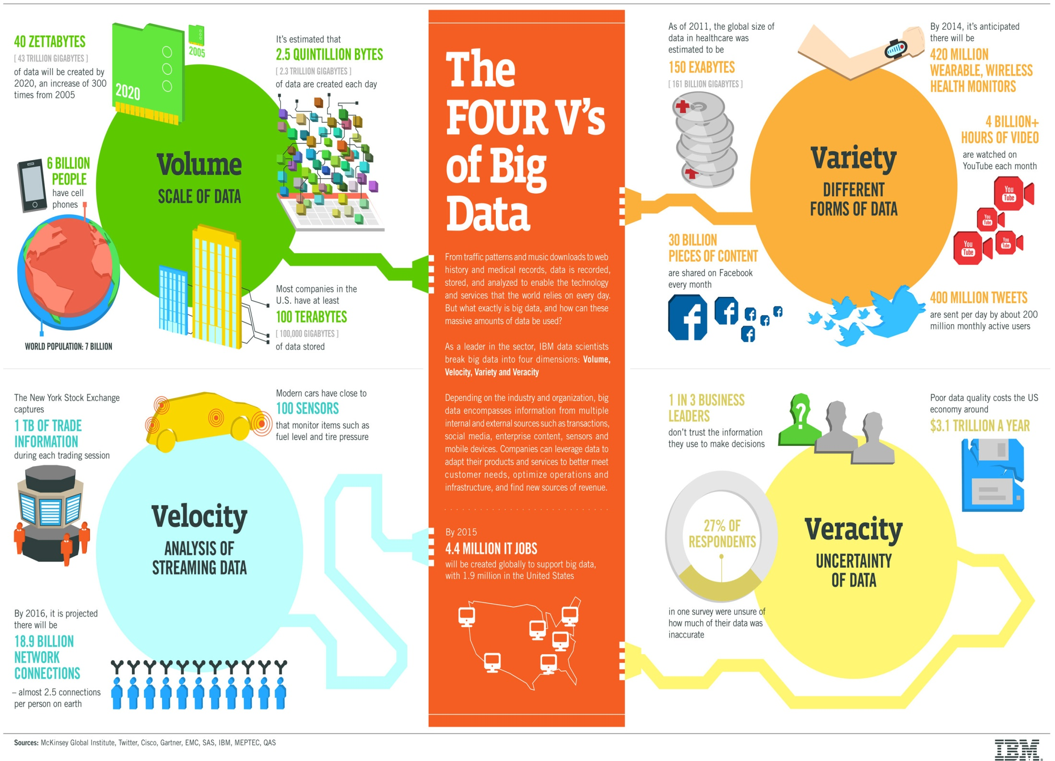

Slide 22
Deriving value from Data
The technological breakthrough is that the cost of data storage and compute has exponentially decreased, thus providing an abundance of data from which statistical sampling and other techniques become relevant, and meaning can be derived.
Big Data is unlike conventional business intelligence, where the simple reporting of a known value reveals a fact, such as summing daily sales into year-to-date sales. With Big Data, the goal is to be clever enough to discover patterns, model hypothesis, and test your predictions. For example, value is discovered through an investigative, iterative querying and/or modeling process, such as asking a question, make a hypothesis, choose data sources, create statistical, visual, or semantic models, evaluate findings, ask more questions, make a new hypothesis – and then start the process again.
Developing Machine Learning: Subject matter experts interpreting visualisations or making interactive knowledge-based queries can be aided by developing ‘machine learning’ adaptive algorithms that can further discover meaning. If your goal is to stay current with the pulse of the data that surrounds you, you will find that Big Data investigations are continuous.

Slide 23
Much of Big Data is Unstructured
Studies indicate that 80% of today’s data collections are not arriving in the traditional, structured formats (like that fits in rows and columns and has been stored in RDBMS for decades)
This new data is composed of images, audio files, tweets, text messages, etc.
Until recently, most organisations have found it difficult to take full advantage of all this unstructured/semi structured data

Slide 24
Big Data classification
Structured Data- RDBMS Data
Semi-structured Data- JSON, XML data
Unstructured data- word files, videos, photos, audio, text, etc.

Slide 25
Schema on Write and Schema on Read
Since the inception of Relational Databases, schema on write has be the defacto procedure for storing data.
Recently there has been a shift to use a schema on read approach, which has led to the exploding popularity of Big Data platforms and NoSQL databases
Schema on write means figure out what your data is first, then write it after.
Schema on read means write your data first, figure out what it is later
Schema on write is good when you know the structure of the data; it is used by SQL Databases eg Oracle, MySQL
Schema on read is flexible and good for unstructured data; it is used by NoSQL Databases eg MongoDB

Slide 26
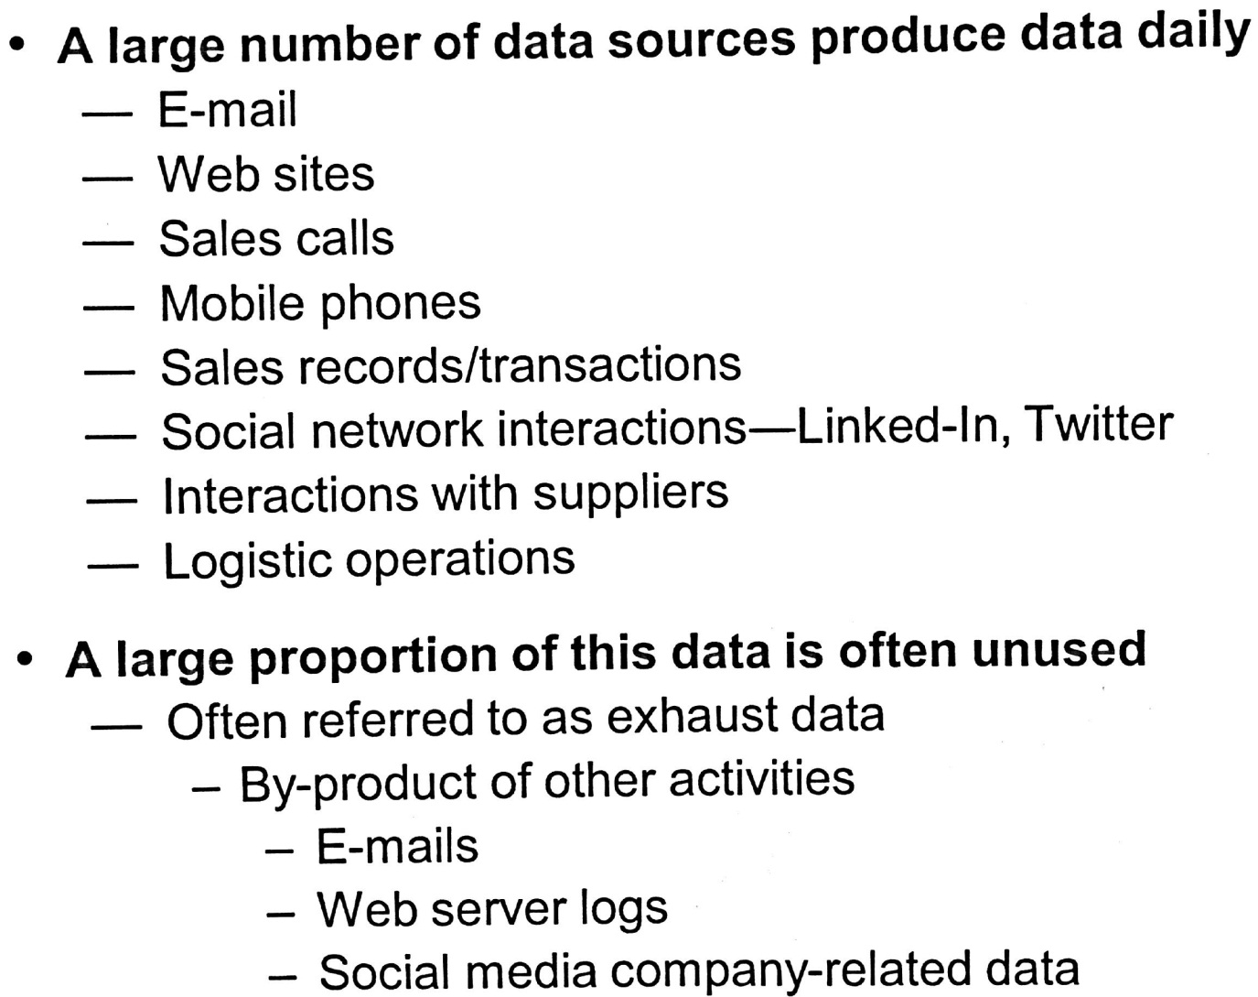
Without Big Data approach, a large proportion of this data is unsued and Business loses this valuable information

Slide 27
Big Data – Examples In Financial Services Industry
Prevent fraudulent activities
Gain deeper knowledge about your customers
Offer new, innovative products and services to customers by having better understanding of them
Make better and faster trading decisions

Slide 28
Big Data – Examples In Retail
Offer smarter cross sell recommendations eg Amazon
Gain a better understanding of purchasing trends
Set optimal pricing and discounts
Monitor Social media to spot satisfied or dissatisfied customers

Slide 29
Examples from Telecoms industry
Deliver the highest quality of service
Quickly identify and correct network anomalies
Make informed decisions about capital investments
Offer highly tailored packages to retain more customers

Slide 30
Trends which are contributing to Big Data growth momentum
New data sources eg IoT
Increasing information quantities
Broader category of Data
Commoditised hardware and software,
rapid adoption and growth of Artificial Intelligence (AI)
Cloud computing is a great fit for Big Data eg Azure, AWS

Slide 31
Larger Data Quantities
Historically, SQL database servers have stored gigabytes of data and reaching that milestone took a long time
In the past 30 years, data warehouses expanded these volumes to terabytes
But in the last 10 years the distributed file systems that store Big Data now routinely house petabytes of data
International Data Corporation (IDC) forecasts that we will generate 175 zettabytes (175 billion terabytes) by 2025. For example, a modern hybrid car can generate around 25 gigabytes of data per hour

Slide 32
Broader Categories of Data
Traditionally relational databases only held records of completed transactions
In Big Data sub-transactional data - which is information that is gathered while the transaction has not yet been completed - is also part of the overall picture.
Examples of sub-transactional data:
Click trails through a website, Shopping cart manipulation, Tweets, etc

Slide 33
Broader Categories of Data - Continued
Relational databases and associated analytic tools are designed to interact with structured data and schema on write approach
But much of the information that makes up today’s Big Data is unstructured or semistructured, eg Photos, Video, XML and JSON documents
RDBMS meeting these challenges vs new Data models

Slide 34
Artificial Intelligence (AI)
Artificial intelligence (AI) apps which includes machine learning (ML) and deep learning (DL), need huge quantities of data to train the AI models to be accurate and effective.
This depends heavily on high quality, diverse, dynamic data inputs and massive amounts of data

Slide 35
Class Question part 1
So isn’t Big Data the same as Enterprise Data?
What are the differences?
Should Big Data applications be standalone or integrate within the enterprise?

Slide 36
Don’t compare Big Data with traditional enterprise Data
Big Data is notably larger — often by several orders of magnitude.
Big Data is commonly generated outside of traditional enterprise applications.
Big Data is often composed of unstructured or semi-structured information types that continually arrive in enormous amounts.
Organisations need to leverage Big Data to gain deeper insights, improve decision making, and provide better services.
Business operations need to integrate Big Data and Big Data sources into their traditional enterprise workflows and applications.
For example, a retailer might want to associate its website visitor behaviour logs (a Big Data application) with purchase information (traditional enterprise data commonly found in RDBMS)

Slide 37
The Challenge of Big Data
Processing power:
The customary approach of using a single, expensive, powerful computer to crunch data does not scale when confronted with the huge amounts of data
A better approach is to create an interconnected network of servers (a Cluster) built on cheap, commoditised hardware and then distribute work tasks to each one
Scale out vs scale up

Slide 38
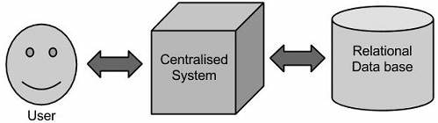
Traditional Approach

Slide 39
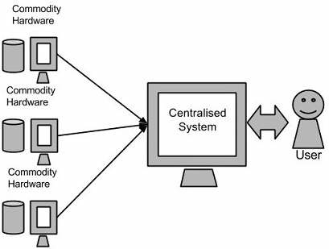
Big Data approach: Exploit Parallelism (using Hadoop)

Slide 40
An Analogy
Suppose you have to build one house. One person is working on it and is expecting to be completed in a year
If we will introduce 12 people to do that job, it will be constructed faster. Can they complete in a month or 2?
They will work parallel and the task will get completed faster
Hadoop gives the ability to perform distributed storage and distributed processing of very large data sets on computer clusters built from commodity hardware

Slide 41
Challenges of Big data
Physical storage: Capturing and managing all this information consumed enormous resources, outstripping all budgetary expectations
Data issues: Lack of data mobility, proprietary formats, and interoperability obstacles all made working with Big Data complicated
Information growth: Unstructured data makes up the vast majority of what needs to be captured today. These massive volumes will swamp most IT organisations or use Cloud Computing!

Slide 42
Scalability
Ability to expand the computer resources to handle growth of work
Enables Database to grow to a larger size to support more transactions as the volume of business and/or no of customer grows. There are 2 types of database scalability :
Vertical Scaling or Scale-up - adding more physical resources eg memory, storage, CPU to improve performance
Horizontal Scaling or Scale-out - shared nothing architecture – cheaper to scale using commodity hardware & more scalable

Slide 43
Data models for Big Data
Relational databases have shared disk subsystem limiting scalability
NoSQL databases based on Document databases in certain circumstances can have better scalability. Examples of Document database are CouchDB, MongoDB
There is Object-relationship mismatch (Impendence mismatch): most program developed today are in OO programming languages eg Java, C#; there is an translation required between the objects in the application code and database made up table, columns and rows

Slide 44
Object Relationship mismatch
In Relational Databases eg Oracle, SQLServer, you need to create the data model in 3 places – in the database, application and ORM. In NoSQL Database eg MongoDB, you create the data model in only on place – the application

Slide 45
Datastores for Big Data: NoSQL – Document Database
Documents DB consist of a key and a JSON document.
Keys: Each document is identified by a unique key. The key is typically a auto generated. You can also choose composite or compound keys. However typically keys are immutable.
JSON documents: JSON provides rich representation for entities. Document databases can parse, index and query JSON values. JSON document attributes can represent both basic types such as number, string, boolean, and complex types including embedded documents and arrays.
Unlike relational databases or some of the TABLE-based NoSQL solutions (Cassandra,Hbase), Document databases do not have Data Definition Language eg CREATE TABLE or ALTER TABLE. The schema of the data is implicit in each document. Developers can simply evolve their applications without any additional administrative action. Schema changes don’t require scheduling downtime

Slide 46
Document Data model advantages
A document database is designed to store semi-structured data as documents, typically in JSON
JSON (Javascript Object Notation) is an open standard file format that uses human readable text to transmit data objects consisting of attribute/value pairs
Increased Schema flexibility (Schema on read rather than Schema on write)
Better performance due to data locality (some relational DBMS overcome by having multi table indexes eg Oracle)
Less data impedance mismatch
Examples are CouchDB, MongoDB

Slide 47
Big Data and the Cloud
Typical scenario:
Big data projects traditionally start with data storage and application of basic analytics modules with infrastructure in- house
However, as you discover ways to extract data and data volumes increase, you will need to find better way to process and analyse data this will require infrastructure upgrade
You add more server capacity to your in-house data warehouse/ data lake but eventually the infrastructure will not be able to keep up
This is where the cloud can provide the ability to deal with Big Data more efficiently and effectively

Slide 48
What is Cloud computing
Cloud computing is the delivery of computing services – servers, storage, databases, networking, software, analytics, intelligence and more – over the Internet
The Cloud offers faster innovation, flexible resources and economies of scale.
You only pay for cloud services you use thereby lowering your operating costs, run your infrastructure more efficiently and scale as your business needs change
Organisation can benefit from the agility, scale, and pay-per-use billing that cloud services offer
Examples of Cloud providers: Amazon AWS & Microsoft Azure (currently the top 2 Cloud providers)

Slide 49
Benefits of Cloud Computing - Speed
Most cloud computing services are provided as self service and on demand.
Vast amounts of computing resources can be provisioned in minutes with just a few mouse clicks thereby giving business flexibility and taking the pressure off capacity planning
Example - if you need 10,000 servers for an overnight big data risk analytics job but only for a few hours you can have them and then you can release them back when completed

Slide 50
Benefits of Cloud Computing - Cost
Cloud computing eliminates the capital expense of buying hardware and software, and setting up and running on-site data centres
the racks of servers, the round-the-clock electricity for power and cooling, the IT experts for managing the infrastructure, etc
Makes it easier to innovate as you don’t have that big hurdle of CapEx
You pay for what you use and no more with no set up costs

Slide 51
Benefits of Cloud computing - Scalability
The benefits of cloud computing services include the ability to scale elastically.
It delivers the correct amount of IT resources eg more or less computing power, storage, bandwidth – when it is needed, and from the correct geographic location
Cloud providers must build enormous data centers all over the world so that computing capability can be accessed from anywhere in the world with similar latency

Slide 52
Class Questions Part II
In which scenario will Schema on read be superior to Schema on write?
You are developing an application in an agile method. Would Schema on read or Schema on write be most appropriate in an agile environment? Please give detailed reasons
What are the disadvantages do you thing of public Cloud Computing may have for your confidential Big Data project?
Should Big Data applications be standalone or integrate within the enterprise?

Slide 53
Big Data Video
https://www.youtube.com/watch?v=8pHzROP1D-w

